Slide 1
Qualitative Research / Needfinding

Slide 2
Qualitative vs. Quantitative Research
Triangulation - Collect data through diverse methods
Qualitative Methods
Examines the way people think and feel (subjective) and includes:
Observations, Interviews, focus groups, etc.
Quantitative Methods
Generates numerical data (objective) and can include:
Surveys, Laboratory experiments, etc.

Slide 3
Fly on the Wall Observations
The “Fly on the Wall” (FOTW) technique is an modest observation technique where the observer has no interaction with the users.
The observer does not interfere.
With fly-on-the-wall observation you observe from a distance.

Slide 4
FOTW, cont.
Goals:
Gain familiarity with the social context being studied.
Observe interactions without influencing the social context.
Helpful in situations in which observations can affect user behavior.
Example:
If you are trying to observe workers, they may show increased productivity in your presence.

Slide 5
Qualitative Method: Interviews
Field Notes/Interviews - Researcher takes notes about the setting
Takes notes
Interviews people
Recommendation: Do not try to recreate dialogue. Take a tape recorder.

Slide 6
Guidelines to taking notes
Are there specific things that you would like to learn about?
Who were the actors present? (provide assumed name if necessary and some description)
What were the main issues or themes that struck you in this setting?
Were there specific issues that you might want to explore further?

Slide 7
Ethnography
What is Ethnography?
Ethnography is a qualitative orientation to research that emphasizes the detailed observation of people in naturally occurring settings.
Studying a group of people
Sharing cultural traits
practices, concepts, beliefs
Why a group does what it does

Slide 8
Ethnography, cont.
Take part in the life of people
Take place in natural setting of the subjects
Ethnographer must observe others and participate with them at the same time

Slide 9
Advantages of Ethnography
Provides a detailed picture of a particular situation.
Findings based on natural setting and lives of the people
Good for studies where the topic:
Is complex
And embedded in a social system that is not fully understood
Think of it as a study that will tell you “what to study quantitatively in the lab” or “what to build”

Slide 10
Disadvantages of Ethnography
High demands of the researcher
Not as well established as surveys/experiments.
Hard to reproduce findings to other areas

Slide 11
How to do an Ethnography
Observation
May include open-ended interview (yes/no questions)

Slide 12
What is Needfinding?
What is Needfinding?
Needfinding is watching and asking people to learn about their goals and values to be able to uncover user needs and opportunities for improvement.
Needfinding resembles ethnographic methods, by making observations and interviewing users, but needfinding leads to design imperatives and product solutions that meet real user needs.

Slide 13
Observing Participants
What do people do?
People are different –
Example: If creating a mobile bus app to figure out the best way to get somewhere, think about the activity
some may want efficiency
others may be concerned more with cost.
Observe them, then interview them.

Slide 14
Interviewing Guidelines
Start in middle. People on top are self-conscious they are too invested. Speak to people in middle.
Questions that aren’t so good:
Is the daily update an important feature to you?
Leading question – most people will say yes if asked if it’s important.
To learn about it observation may be effective – see if someone used it. Or log files to see.
“I see from the log you never used the daily update, why is that? Tell me more?”
More open-ended – the more interesting the answer you get.
Scott Klemmor hci-class.org

Slide 15
Interview: Good Questions
Avoid:
Asking what they do or want in hypothetical scenario.
“How often” – they will lie (Ex. how often exercise).
Rather, make things concrete – “How much exercise this week” vs. “How much exercise in a typical week”
Avoid binary yes/no.
Rather, use Open-Ended questions -Let them respond.
Let some silence happen and they will talk.
Example: Teaching – “Does anyone know the answer” then teacher answers. No reason to participate. Wait longer, a few more seconds and someone will chime in.
Scott Klemmor hci-class.org

Slide 16
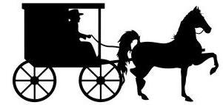
Interview: Bad Questions
Bad questions:
“What would you like in a tool?”
Users are only experts in their own lives not design. They won’t know what to say.
Example: Horse and Buggy – what do you want? Faster horse. They don’t know about a car – designers do. Not users.
Scott Klemmor hci-class.org

Slide 17
Designers vs. Users
Designer - comes up with design.
Users do not.
Though sometimes advanced users (aka lead users) can help design with a creative solution.

Slide 18
Participatory Design
Participatory Design/Co-Design-an approach which actively involves users. Equal collaboration between user and designer.

Slide 19
What power should the designer have?
In the traditional design process, designers hold positions of power and status. They decide which stakeholders to engage with, how to prioritize each stakeholder’s needs, and which design concepts to move forward with.
This power is a source of tension: synthesis is the designer’s role and expertise, but it also cuts out stakeholders from direct or indirect control

Slide 20
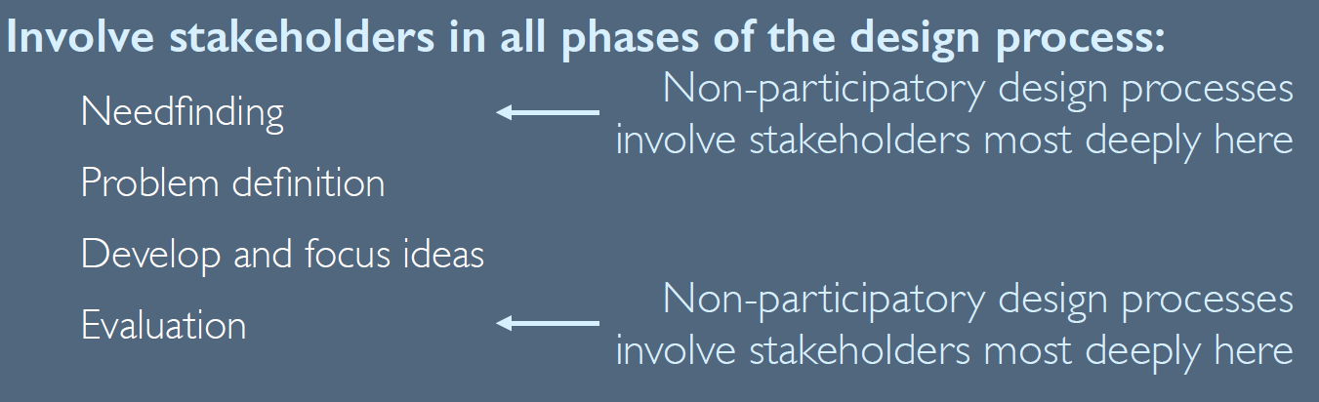
Participatory design
design process that de-centers the designer’s role

Slide 21
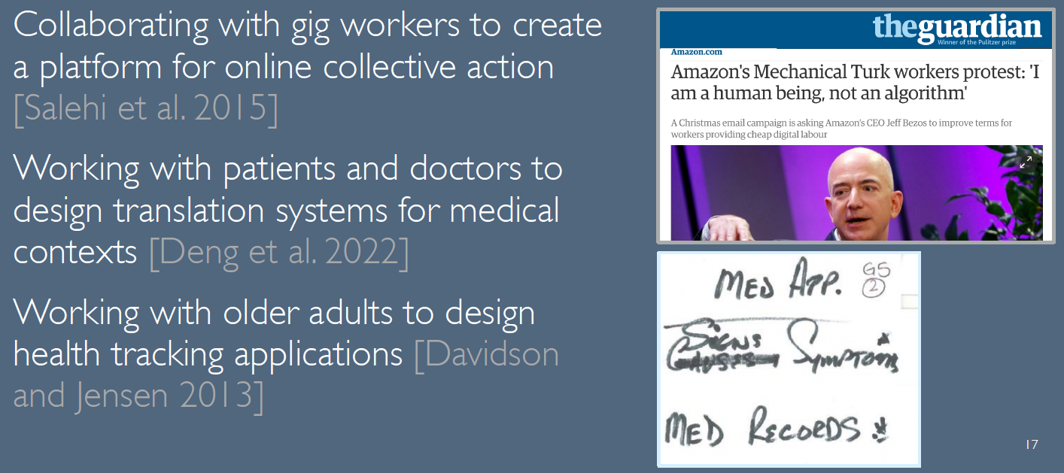
Examples

Slide 22
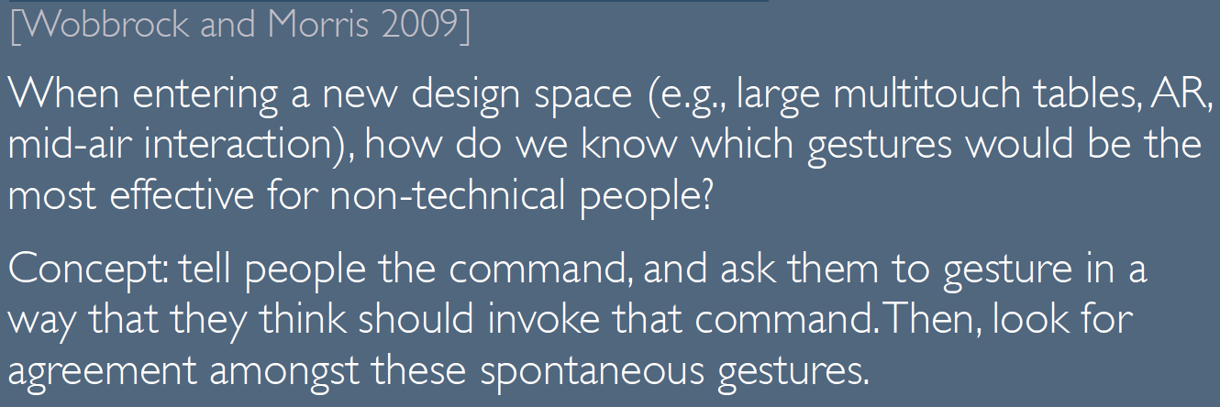
Elicitation studies

Slide 23
Recruiting Participants – Who to observe/interview?
Get representatives of the target audience of the system. Participants who would be using it.
May be current users of the system. (Or perhaps your technology broadens who currently uses the system.)

Slide 24
Who to Observe/Interview
Example: Lecture support system.
Teacher, student, department administrator, or maybe parents.
Freshman and Ph.D. student
Domestic and international
In major / out of major
Stronger student / weaker student
Won’t have all but get different people from different groups.
*from Scott Klemmor hci-class.org

Slide 25
Interviewing, cont.
You may not get exactly what you want but approximate.
Example:
System for doctors – may need to use medical students instead of doctors.
computer science students instead of software engineers.
Not ideal but better than nothing.
*from Scott Klemmor hci-class.org

Slide 26
Find People to Interview
Finding Participants:
Reach out through friends and family – social network. Ask your sister who she knows, or friends of friends.
Pay participants: Craigslist $50-$100.
Cheaper for less specialized users.
Cheaper if you say it will make world a better place – maybe even for free.
If it will be used for a profit, a participant will want to be paid.
Or token of appreciation – gift certificate.
Scott Klemmor hci-class.org

Slide 27
Extreme users
Extreme users- what aspect of your design do you want to explore to an extreme.
Example: Email –
Extreme users get far more emails than the average user – thousands of messages a day. If you can help them, you can help anyone.
Or a person in a cabin who checks email once a month.
*from Scott Klemmor hci-class.org

Slide 28
Personas
Keep in mind actual users throughout the design process.
Create Personas who represent a type of users.
include demographic information and their motivation.
Can even have a picture or photo.
Give them a name and background/occupation, hopes and dreams, they should have a story.
Can relate and have empathy to a persona who seems real.
This helps the design be coherent rather than scattered.
Scott Klemmor hci-class.org

Slide 29
Process
Needfinding - what people say and do
Storyboard – focus on task not user interface
Prototype – extension of the storyboard without technical coding
Heuristic Evaluation – Evaluate the prototype. Expensive to constantly use users (3-5 experts)
Usability Testing – USERS!
Designing Experiments – How to run a design study.

